Slide 1

TRADING DOLLARS FOR DOLLARS ?
Exchange Rates and Payments with the Rest of the World

Slide 2
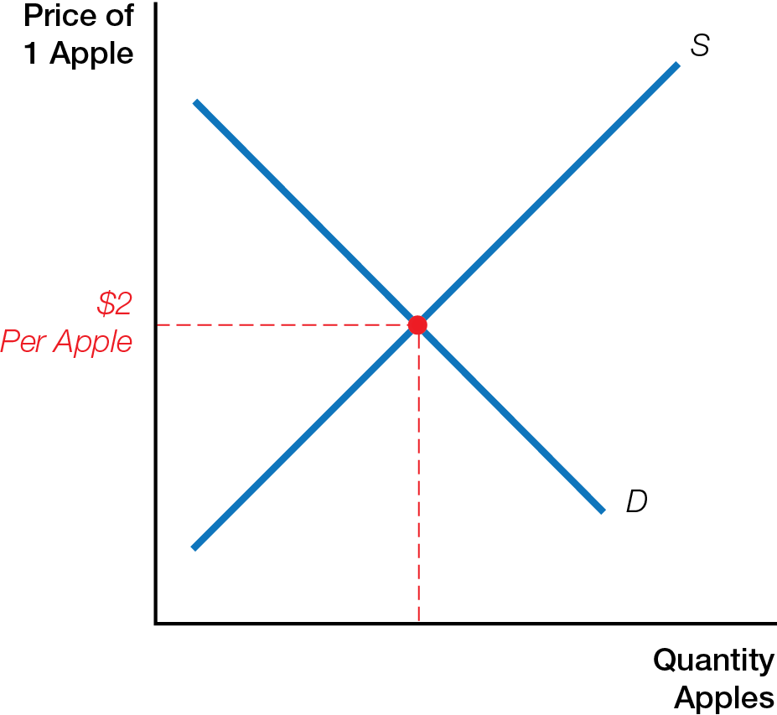
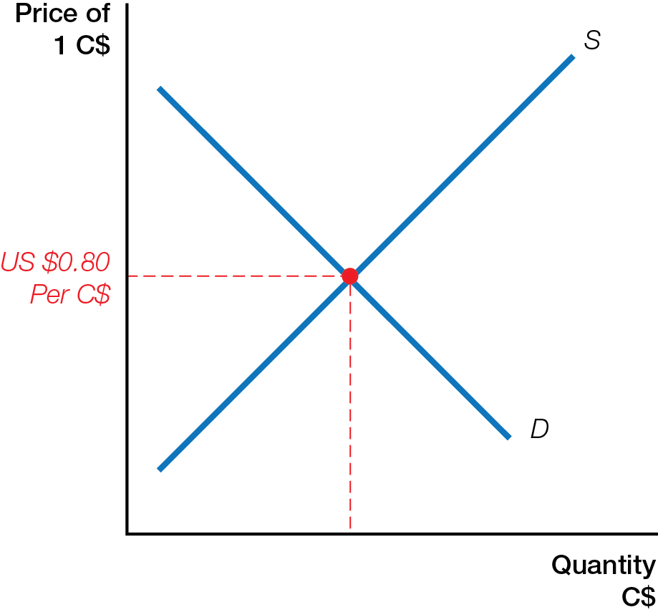
How Does the Price of an Apple Differ from the Price of a Canadian Dollar (C$) ?
Apple Market
Foreign Exchange Market

Slide 3
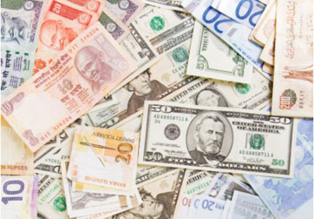
DEMAND AND SUPPLY OF CANADIAN DOLLARS
The demand for products, services, and assets from other countries, which must be paid for in local currencies, are behind demand and supply on the foreign exchange market, determining exchange rates.

Slide 4
Exchange rate price one currency exchanges for another currency
Exchange rate is the price of 1 Canadian dollar
If the price of C$1.00 = US$0.80, it takes 80 cents U.S. to buy 1 Canadian dollar
Foreign exchange market worldwide market where currencies bought and sold
Currency depreciation fall in exchange rate of one currency for another
Currency appreciation rise in exchange rate of one currency for another

Slide 5
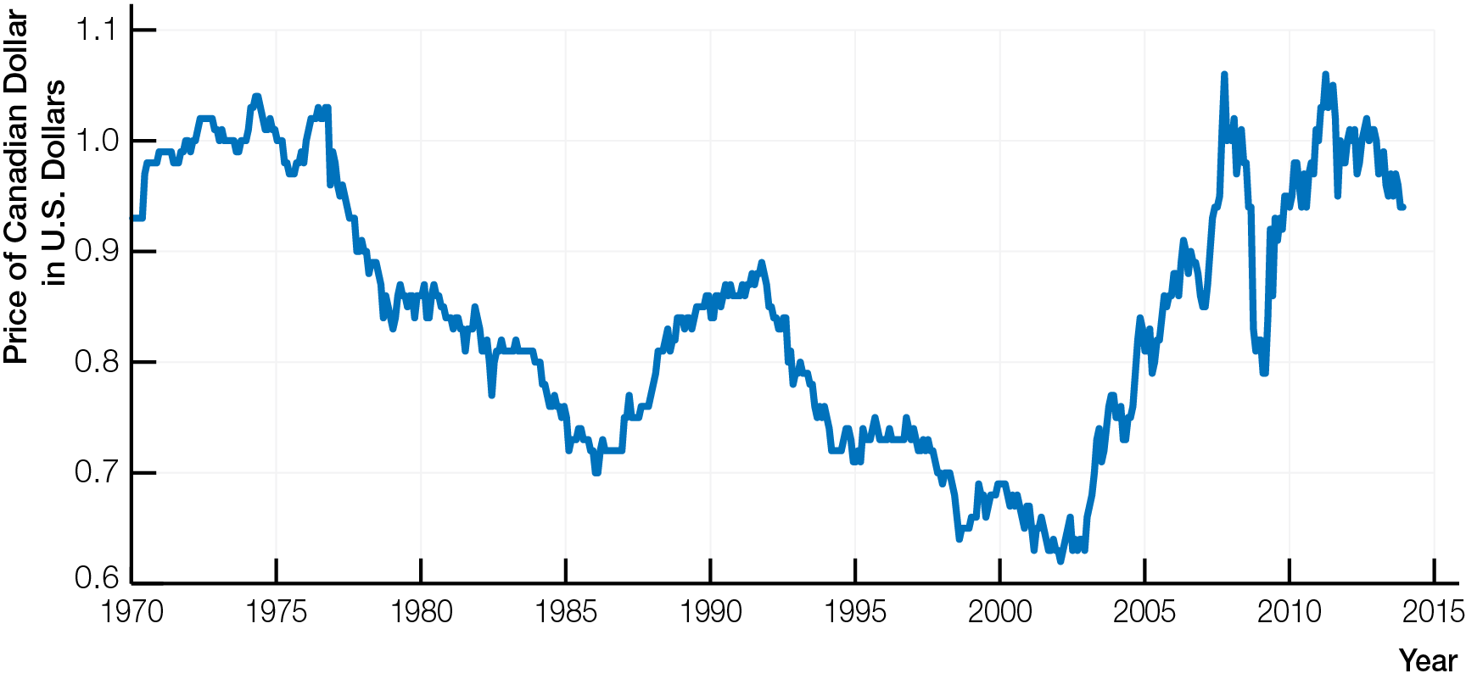
Exchange Rate of Canadian Dollar in U.S. Dollars, 1970 - 2014

Slide 6
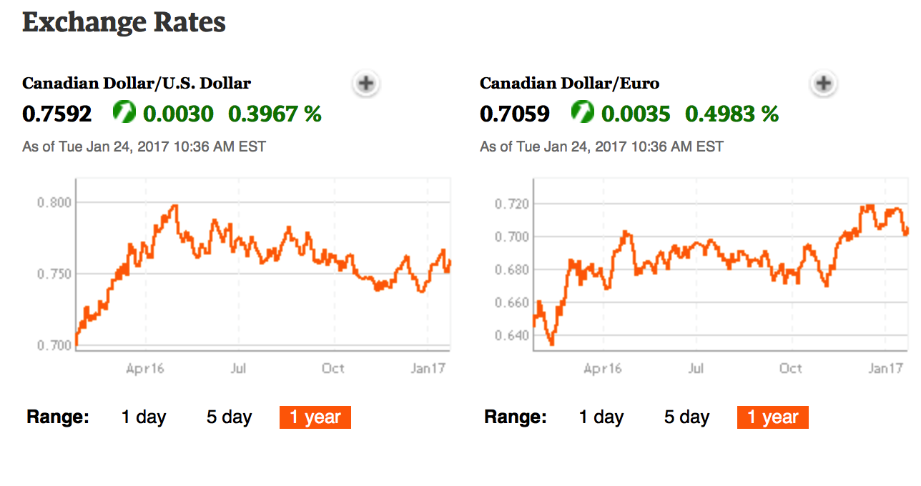
Exchange Rate of Canadian Dollar in U.S. Dollars and Euros

Slide 7
Non-Canadians’ demand for C$ is demand for
Canadian exports and assets
Speculating on future value of C$
Law of demand for Canadian dollars as exchange rate rises, quantity demanded of C$ decreases
With higher value of C$
Canadian exports and assets more expensive for R.O.W.
R.O.W. buys less
Quantity demanded of C$ decreases

Slide 8
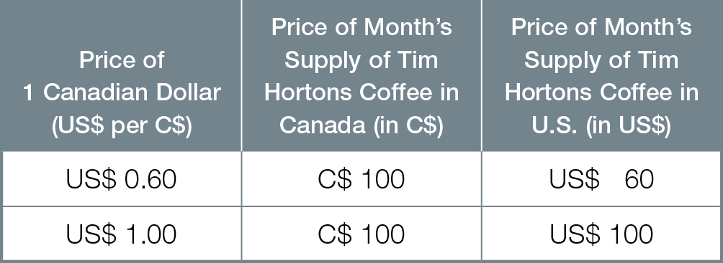
Price of Tim Hortons Coffee in Canada and the United States

Slide 9
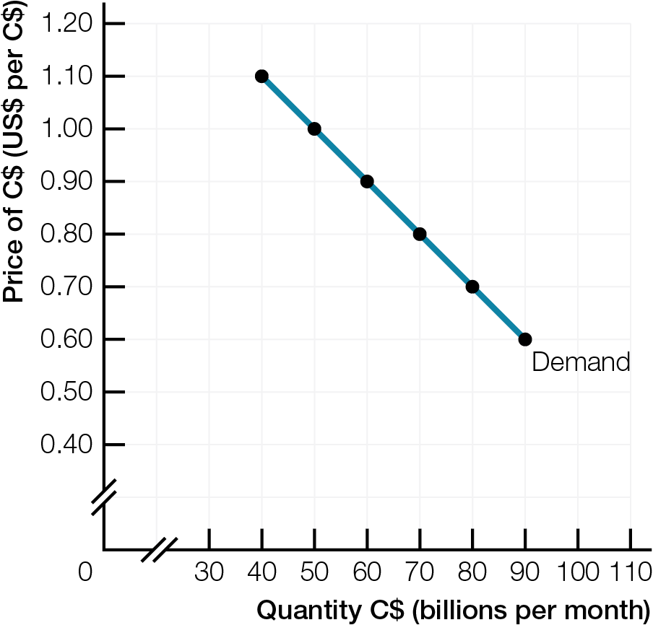
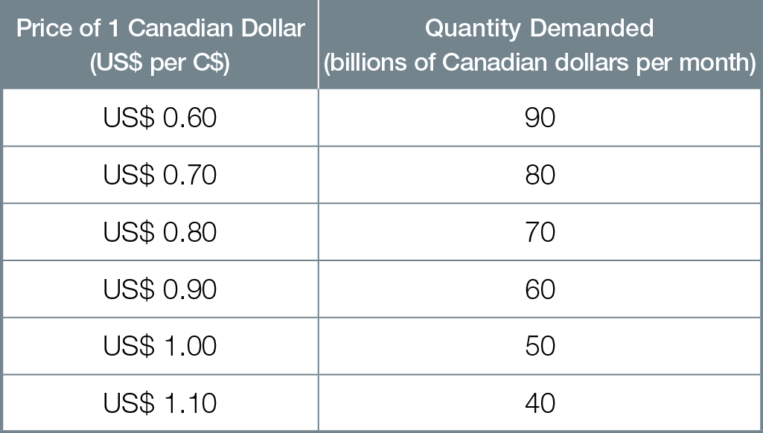
Demand for Canadian Dollars in Foreign Exchange Market

Slide 10
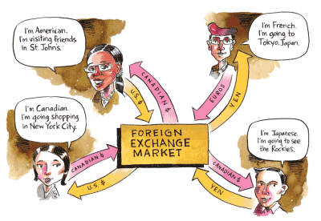
Canadians’ supply of C$ is demand for
Foreign currency to buy imports & assets from R.O.W.
Speculating on future value of C$
Supply of one currency is demand for another currency

Slide 11
Law of supply for Canadian dollars as exchange rate rises, quantity supplied of C$ increases
With higher value of C$
R.O.W. imports and assets less expensive for Canadians
Canadians buy more of them
Canadians need/demand more foreign currency, so quantity supplied of C$ increases

Slide 12
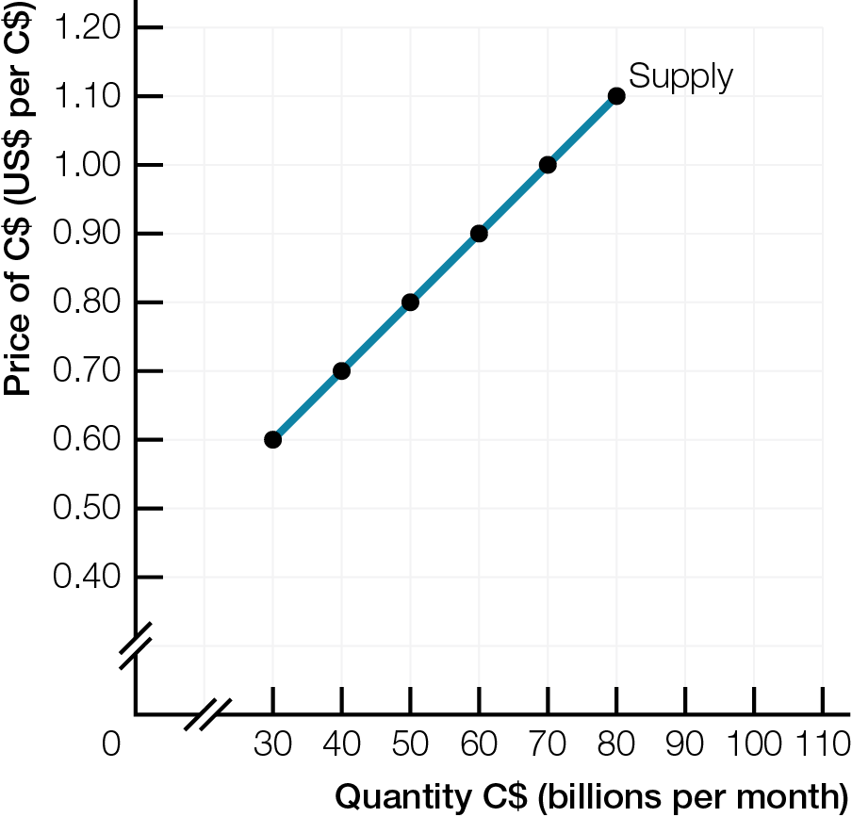
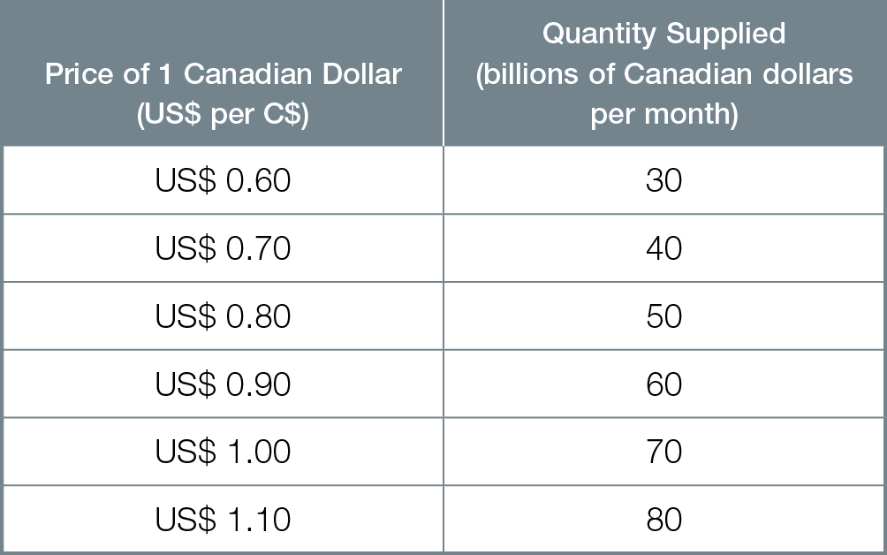
Supply of Canadian Dollars in Foreign Exchange Market

Slide 13
At equilibrium exchange rate, quantity demanded = quantity supplied of C$
Adjustment to equilibrium
Below equilibrium exchange rate, excess demand (shortages) for C$, buyers’ competition causes exchange rate to rise
Above equilibrium exchange rate, excess supply (surpluses) for C$, sellers’ competition causes exchange rate to fall

Slide 14
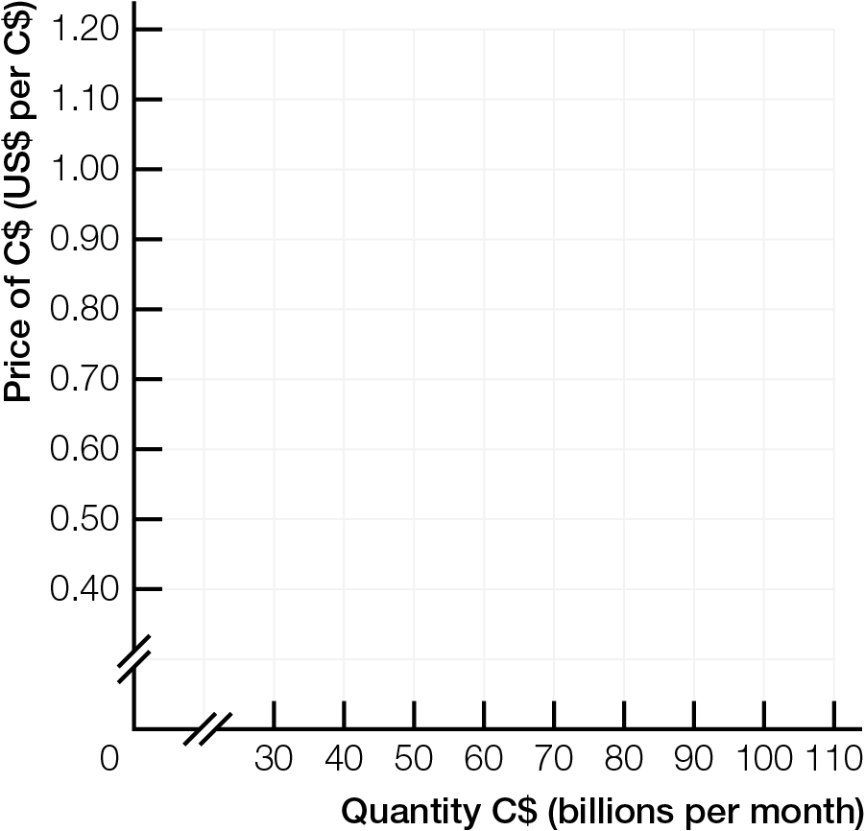
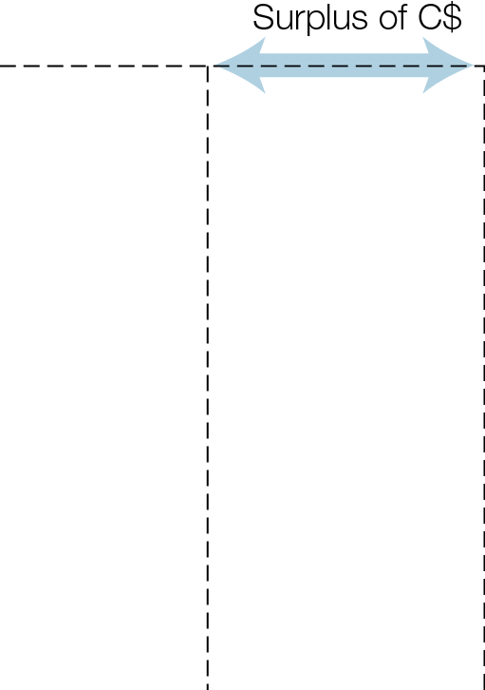
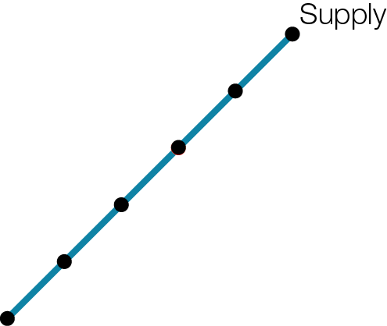
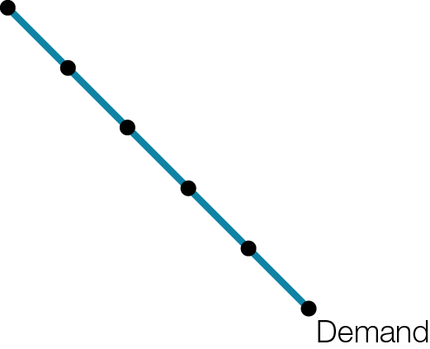
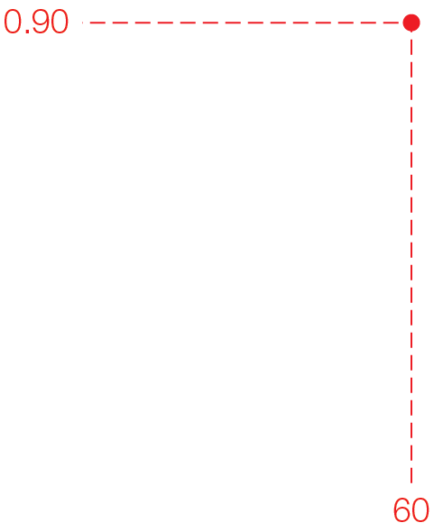
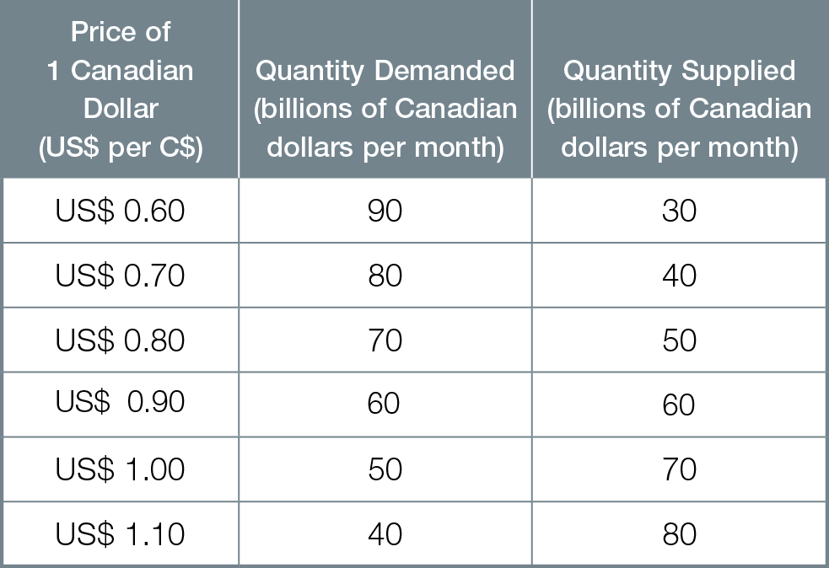
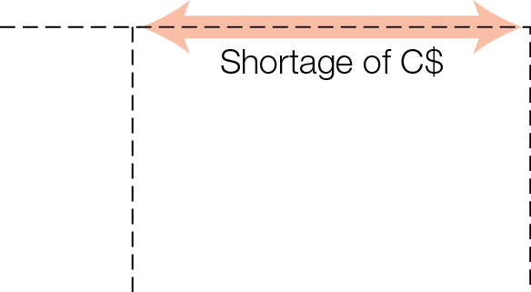
Foreign Exchange Market for Canadian Dollars
Fig. 10.5

Slide 15
Remember, supply of one currency is demand for another currency
Americans demanding C$ supply US$ in exchange
Canadians demanding US$ supply C$ in exchange
For reciprocal exchange rate, divide 1 by the other exchange rate
If C$1.00 = US$0.80, reciprocal exchange rate is US$1.00 = 1 ÷ 0.80 = C$1.25
When C$ appreciates against any currency, that currency depreciates against C$, and vice versa

Slide 16
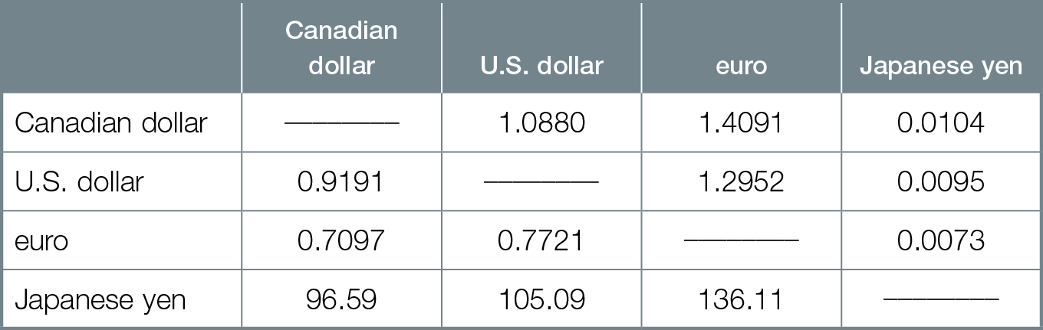
Foreign Exchange Cross Rates
=
=
=
=

Slide 17
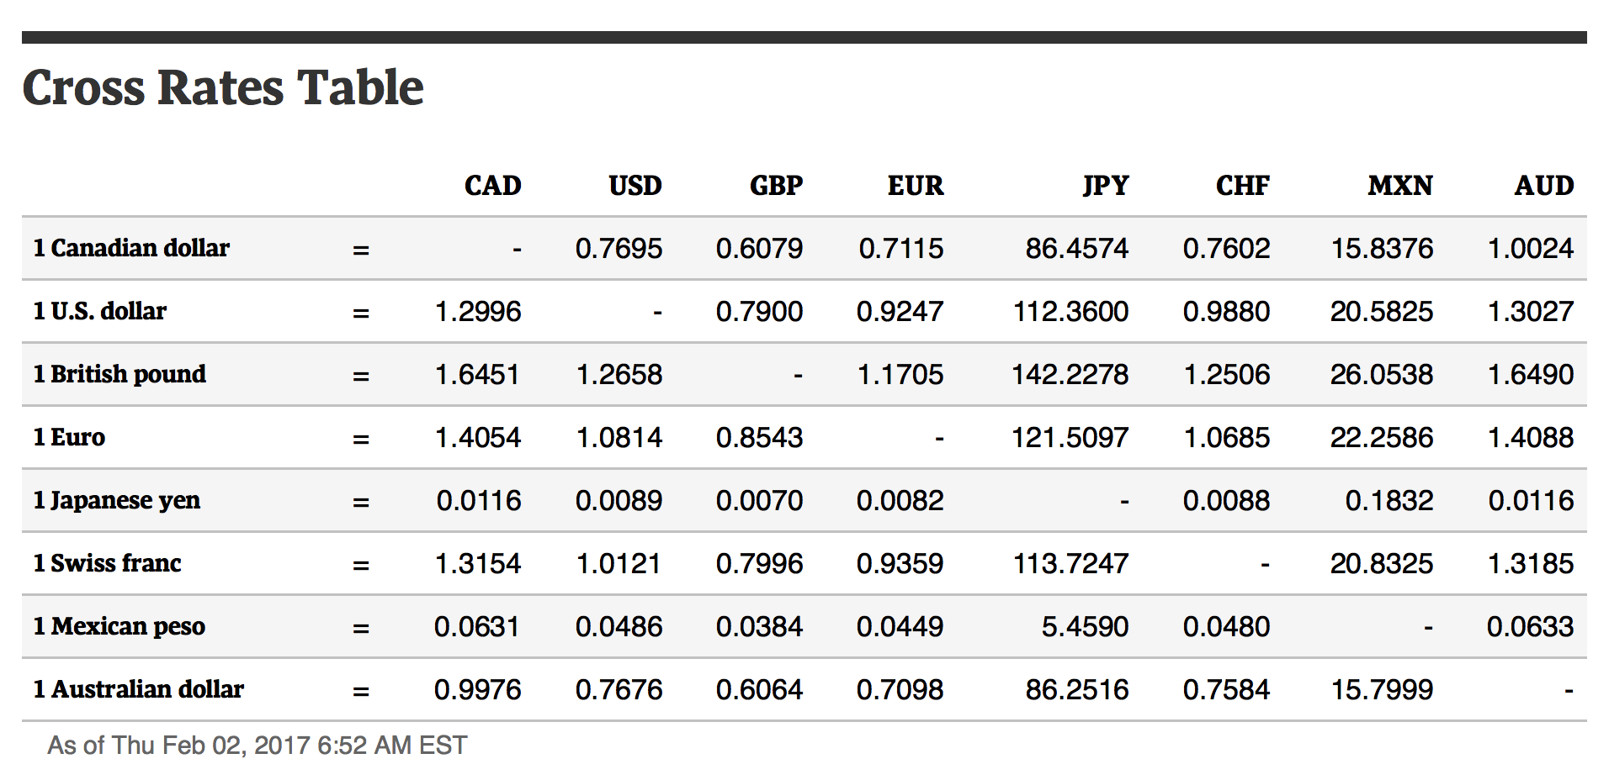
Foreign Exchange Cross Rates - February 2017

Slide 18

FLUCTUATING EXCHANGE RATES
Exchange rate fluctuations are caused by changes in interest rate differentials, inflation rate differentials, Canadian real GDP, R.O.W. demand for Canadian exports and world prices, and expectations by speculators.

Slide 19
Many economic forces changes both demand (curve) and supply (curve) in the foreign exchange market
Interest rate differential difference in interest rates between countries
Increase in Canadian interest rate differential causes C$ to appreciate (increases demand and decreases supply of C$)

Slide 20
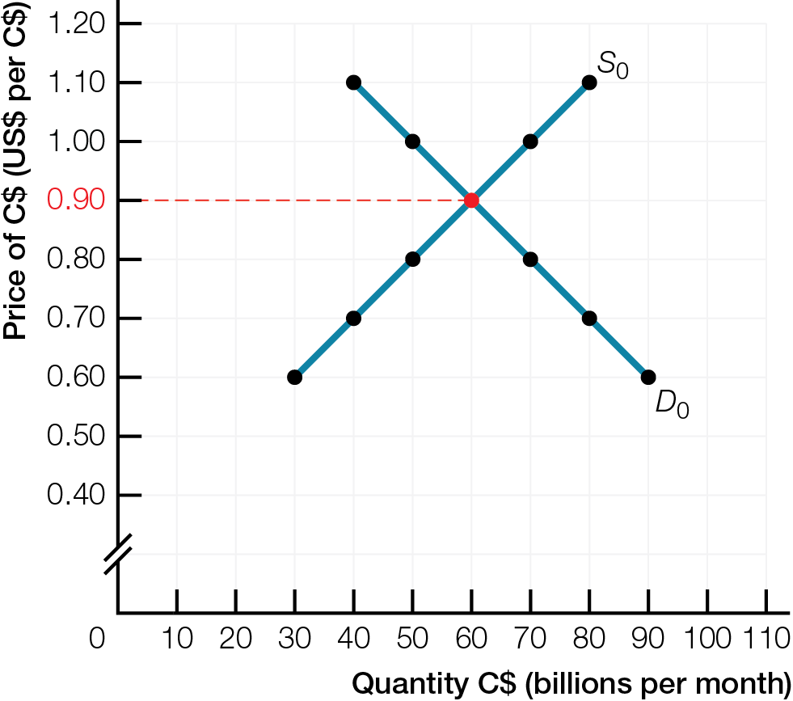
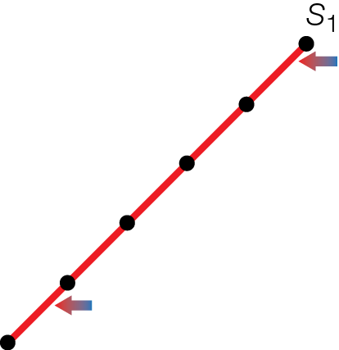
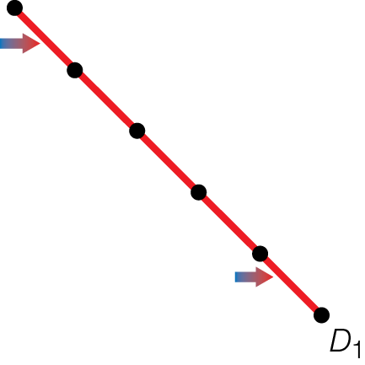
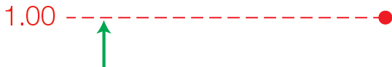
Increase in Demand & Decrease in Supply of Canadian Dollars in Foreign Exchange Market

Slide 21
Inflation rate differential difference in inflation rates between countries
Increase in Canadian inflation rate differential causes C$ to depreciate (decreases demand and increases supply of C$)

Slide 22
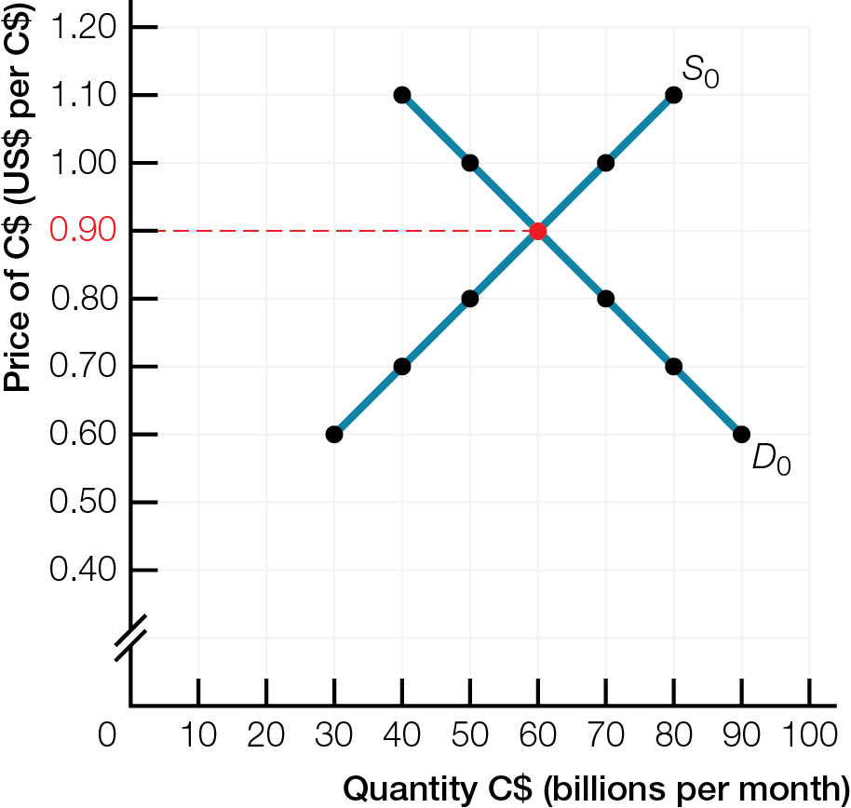
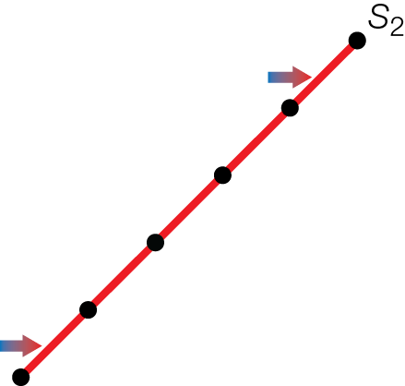
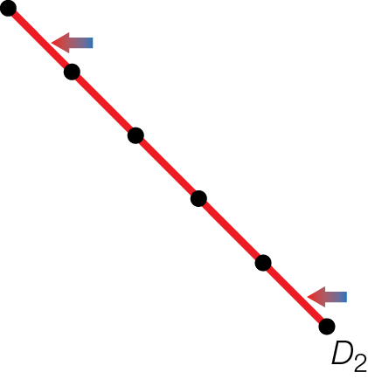
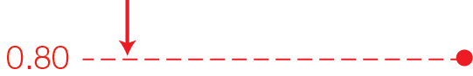
Decrease in Demand & Increase in Supply of Canadian Dollars in Foreign Exchange Market
Fig. 10.8

Slide 23
Effects of increasing Canadian real GDP on C$
Increased investor confidence causes strong appreciation (big increase demand C$, decrease supply C$)
[Less important] Increased imports ➔ small depreciation (small increase supply C$)
Net effect is C$ appreciates

Slide 24
SOLO CHANGES IN DEMAND FOR C$
Increasing R.O.W. demand for Canadian exports causes slight appreciation of C$ (increases demand for C$)
Rising world prices for Canadian resource exports causes C$ to appreciate relative to currencies of non–resource producing countries (increases demand for C$)

Slide 25
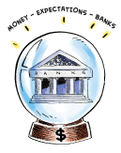
Currency speculators are the most important force for fluctuations of foreign exchange rates
Daily value world goods trade 2013 = $52 billion Daily value foreign exchange 2013 = $5.3 trillion Speculators behind 99% of FOREX transactions
Expected rise in future price of the C$ causes appreciation of C$ (increases demand for C$)
Speculators reinforce and speed up effects of other forces on the price of C$

Slide 26
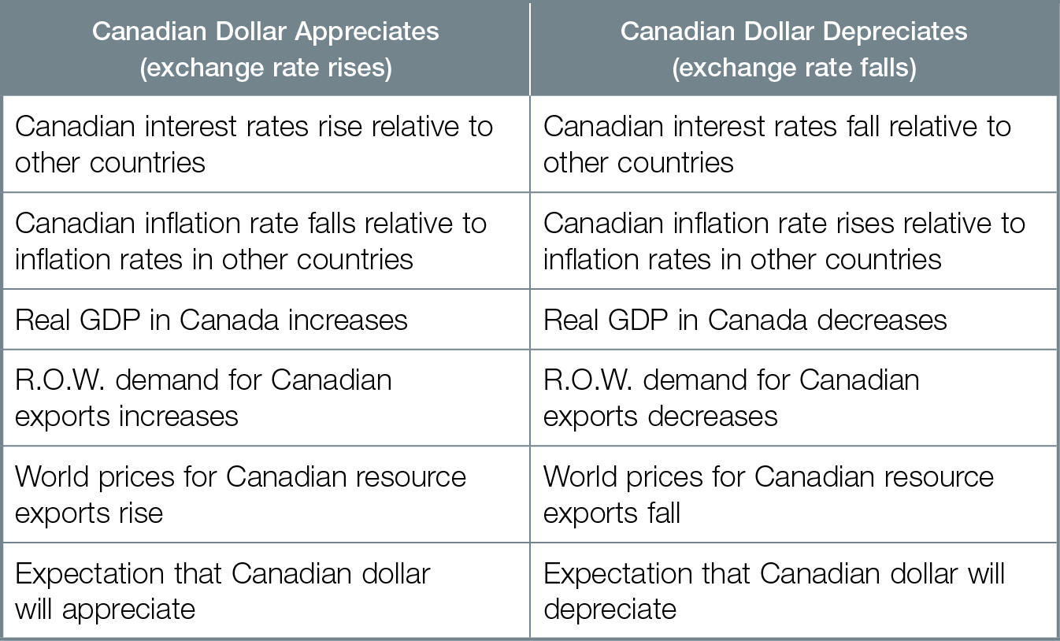
Forces Changing the Price of the Canadian Dollar

Slide 27
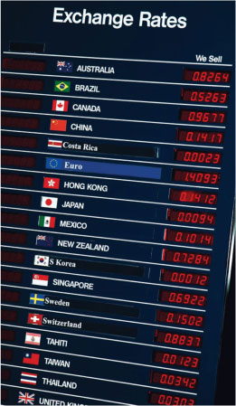
INTERNATIONAL TRANSMISSION MECHANISMS
Exchange rates affect real GDP and inflation through the international transmission mechanism affecting net exports, aggregate demand, and the price level.

Slide 28
International transmission mechanism how exchange rates affect real GDP and inflation
Appreciating C$ is negative aggregate demand shock
Decreases net exports; decreasing aggregate demand, decreasing real GDP, increasing unemployment
Decreases inflation
Pushes the economy into a contraction

Slide 29
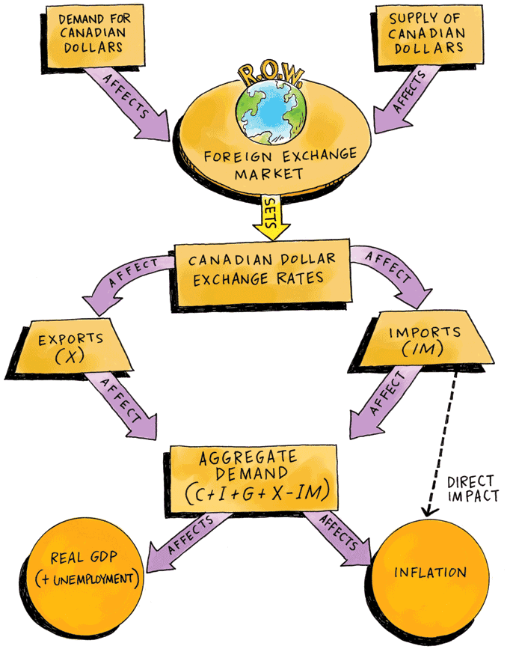
International Transmission Mechanism

Slide 30
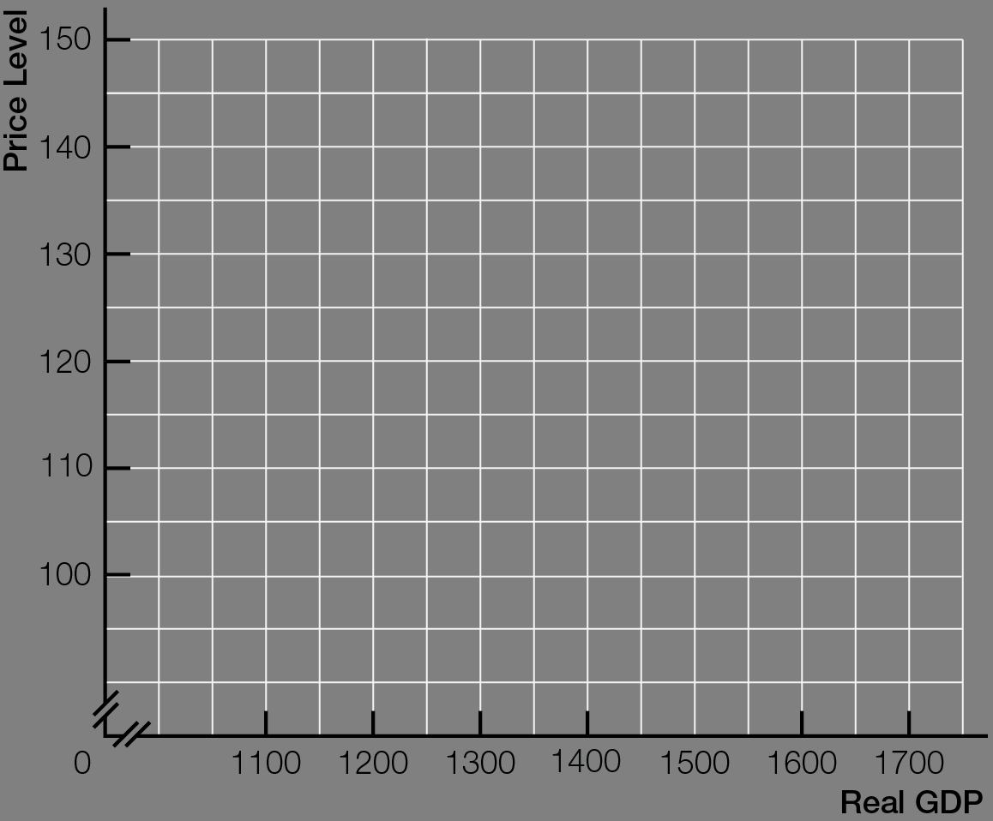
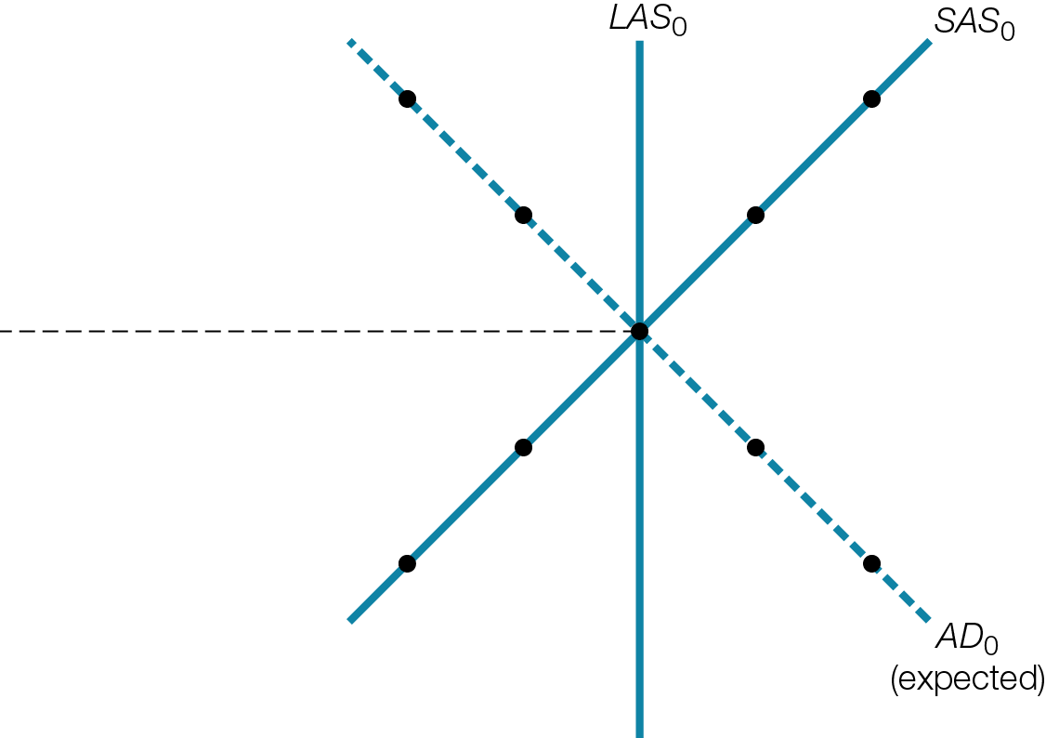
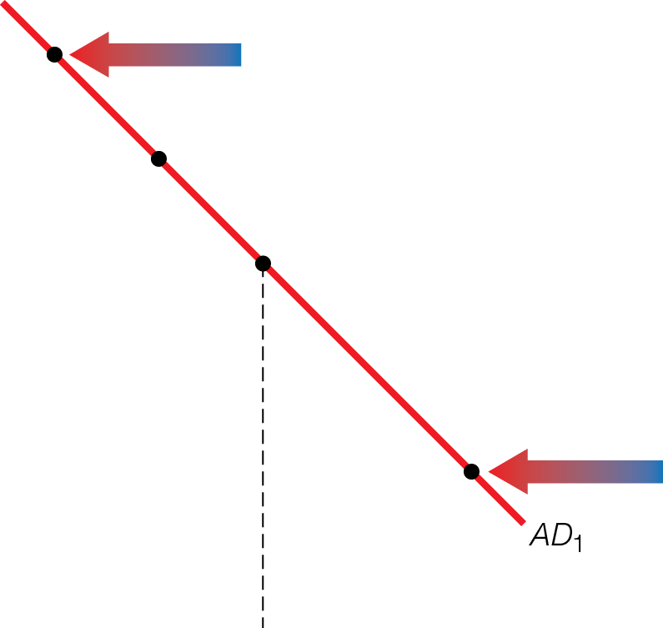

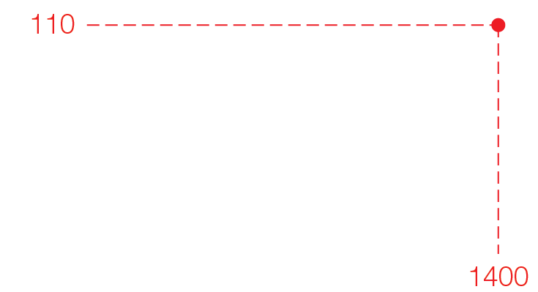

Negative Demand Shock from Appreciating C$

Slide 31
Depreciating C$ is positive aggregate demand shock
Increases net exports; increasing aggregate demand, increasing real GDP, decreasing unemployment
Increases inflation
Pushes the economy into expansion

Slide 32
International Transmission Mechanism

Slide 33


Slide 34
Advantages and disadvantages to both higher and lower exchange rates
Appreciating C$ makes imports less expensive, but is negative demand shock, hurting exporters, decreasing real GDP, increasing unemployment, decreasing inflation
Depreciating C$ makes imports more expensive, but is positive demand shock, helping exporters, increasing real GDP, decreasing unemployment, increasing inflation
There is no socially “best” exchange rate – only trade-offs between winning and losing groups

Slide 35
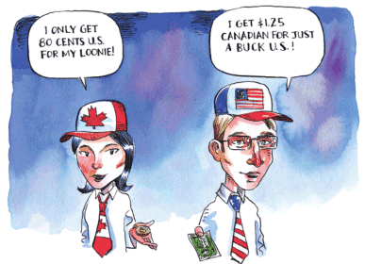
PURCHASING POWER PARITY AND RATE OF RETURN ANCHORS
The law of one price, purchasing power parity, and rate of return parity are the best available standards for predicting where exchange rates eventually settle, despite their limitations.
Notes:
.

Slide 36
Predictions where exchange rates settle based on law of one price profit seekers eliminate differences across markets in prices of same product
Purchasing power parity (PPP) exchange rates adjust so that money has equal real purchasing power in any country
C$15 buys exactly same products in Canada — and when converted into US$ at PPP exchange rate — and in the United States

Slide 37
Example of Screen Protectors C$ 15 US$ 10
If $1 Canadian = 67 cents US, then PPP
Money, when converted to other currency, buys same real goods
If purchasing power parity does not hold, for example, Canadian $ more valuable than U.S. dollar for purchases (C$1 = US$1)
→ people sell C$ for US$ → ↑ supply Canadian $
→ Canadian $ depreciates

Slide 38
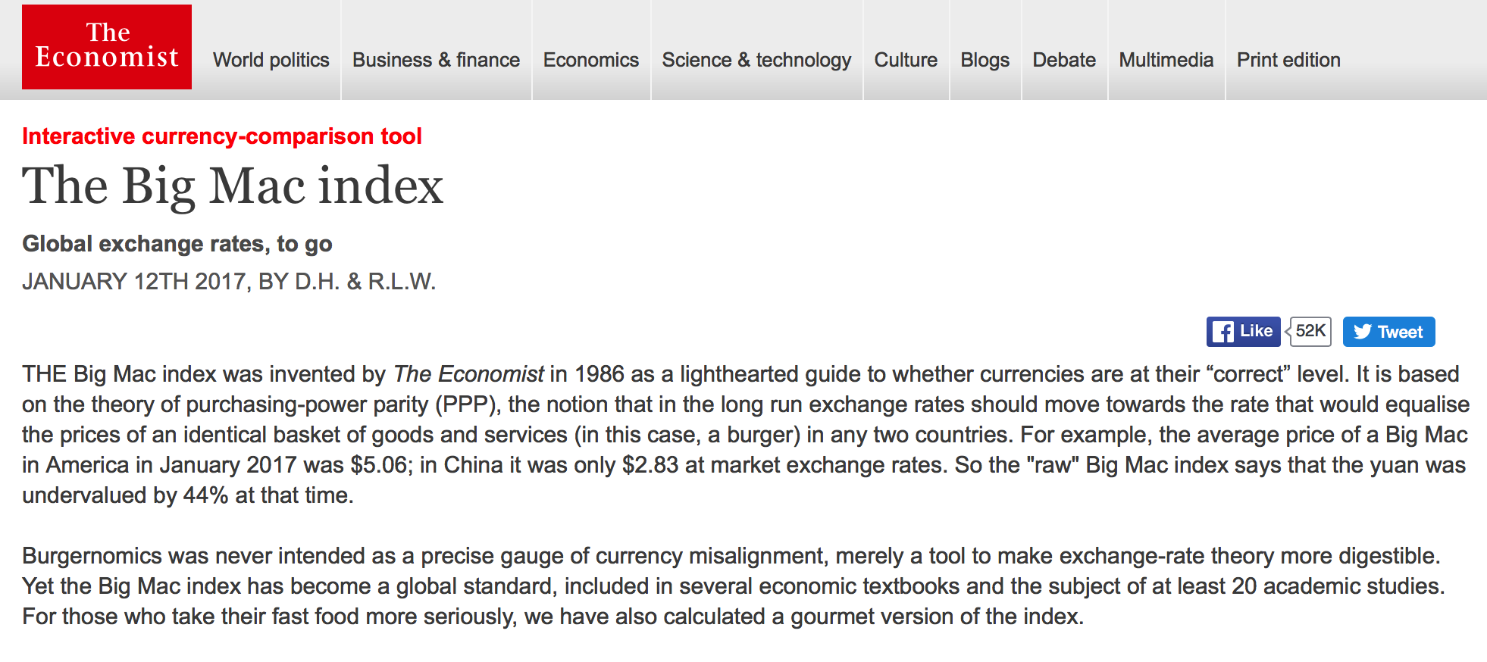

Slide 39
Big Mac Purchasing Power Parity Index
Big Mac costs US$4.80 in US

Slide 40
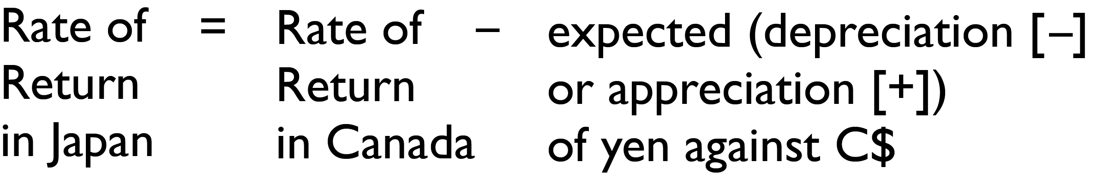
When PPP does not exist, profit-seeking forces and law of one price push exchange rate toward PPP rate
PPP does not account for trading limitations and the role of speculators influencing exchange rates
Rate of return parity (interest rate parity) rates of return on investments are equal across countries, accounting for expected depreciation or appreciation of exchange rates

Slide 41
Example
3% = 5% − (+2%)
Japanese investor converts yen into C$ to invest at 5%. At year end, must convert C$ back to yen.
Yen appreciated by 2%, so C$ depreciated by 2%.
Outcome
5% return in Canada − 2% loss converting C$ back to yen = 3% return (same as rate if invested in Japan)

Slide 42
Different systems for determining exchange rates
Floating exchange rate determined by demand and supply in foreign exchange market
Fixed exchange rate determined by governments or central banks [Earlier gold standard as fixed exchange rate]

Slide 43
INTERNATIONAL BALANCE OF PAYMENTS
The two main parts of the balance of payments accounts — the current account and the financial account — must add up to zero.

Slide 44
Balance of payments accounts measure a country’s international transactions
Current account
Financial (capital) account
Statistical discrepancy
Flows of C$
Into Canada are positive numbers on balance of payments accounts
Out of Canada are negative numbers

Slide 45
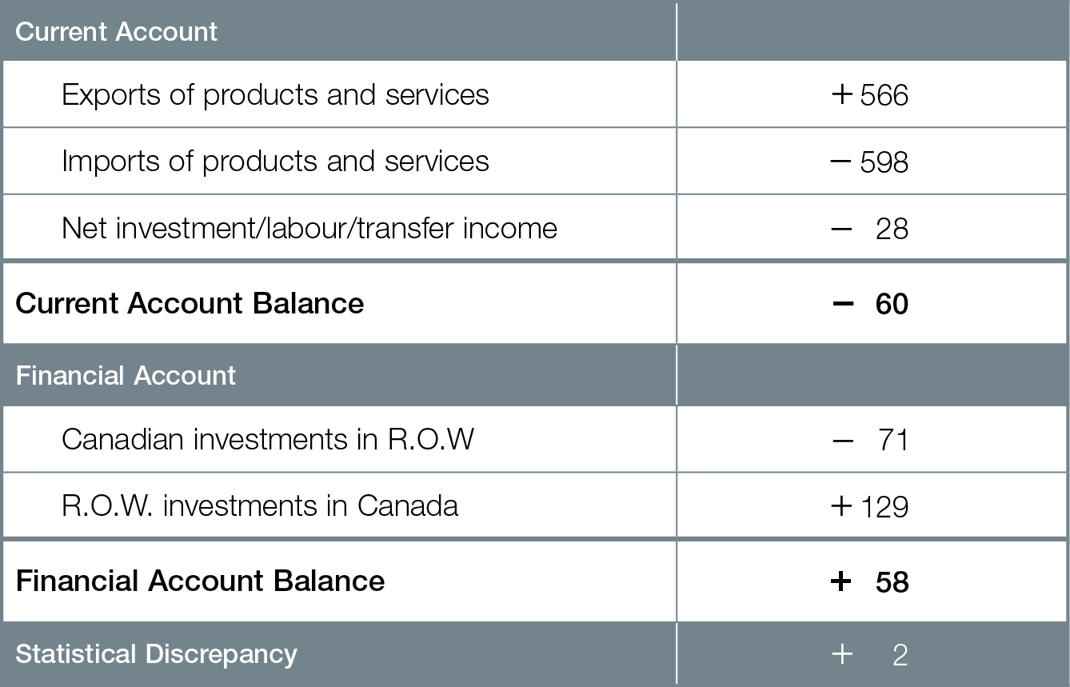
Canada’s Balance of Payment Accounts 2013

Slide 46
Current account measures flows from exports, imports (and net investment/labour/transfer income)
Canadian exports create positive inflow of C$; imports create negative outflow of C$
Current account deficit (negative balance) when Canadian spending on imports from R.O.W. is greater than R.O.W. spending on Canadian exports (and net investment/labour/transfers)
Current account surplus (positive balance) when R.O.W. spending on Canadian exports is greater than Canadian spending on imports from R.O.W (and net investment/labour/transfers)

Slide 47
Financial (capital) account measures international investments in financial assets like bonds and direct investment in buying companies
Canadian investments in R.O.W. are negative outflow of C$; R.O.W. investments in Canada are positive inflow of C$
Financial account deficit (negative balance) when Canadian investments in R.O.W. greater than R.O.W. investments in Canada
Financial account surplus (positive balance) when R.O.W. investments in Canada are greater than Canadian investments in R.O.W.

Slide 48
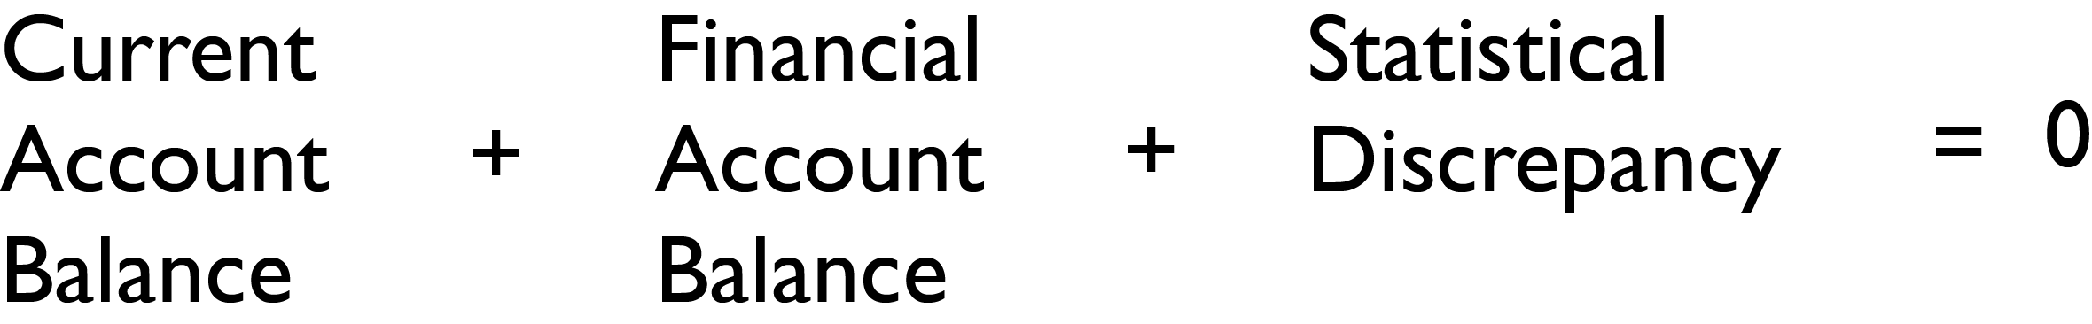
Statistical discrepancy for missing data and errors is not important for balance of payments accounts
The balance of payments accounts must add to zero

Slide 49
When there is a current account surplus there is a financial (capital) account deficit
If R.O.W. spends more on Canadian exports than Canadians spend on R.O.W. imports, where does R.O.W. get extra C$?
From financial account deficit, with Canadians “loaning” R.O.W. extra C$ through investments

Slide 50
When there is a current account deficit there is a financial (capital) account surplus
If Canada spends more on R.O.W. imports than R.O.W. spends on Canadian exports, where does Canada get extra foreign currency ?
From financial account surplus, with R.O.W. “loaning” Canada extra foreign currency through investments

